Slide 1
School principal as a leader of instructional process
LEPL Rustavi #4 Public School
Mamuka Khamkhadze

Slide 2
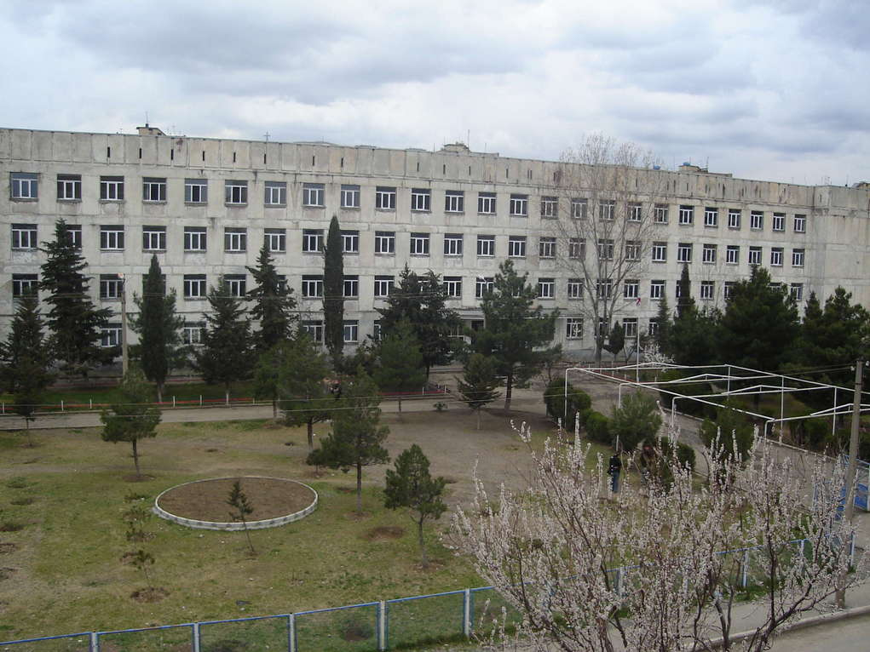
LEPL Zhiuli Shartava Rustavi #4 Public School

Slide 3
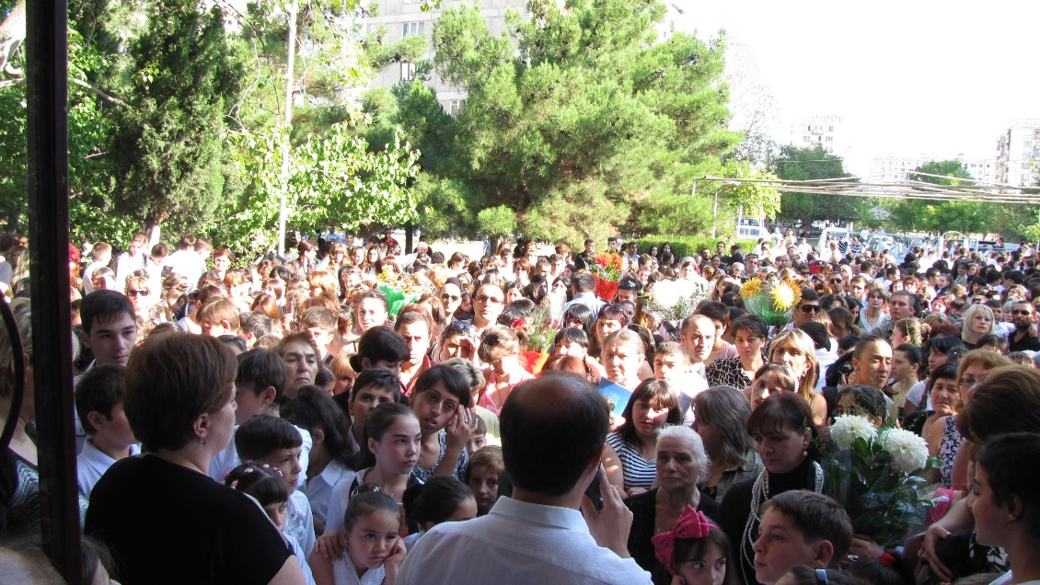
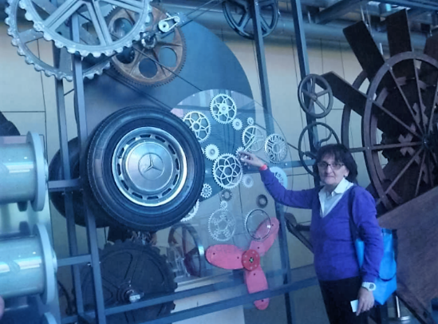
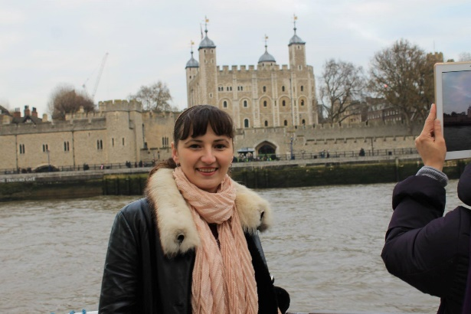
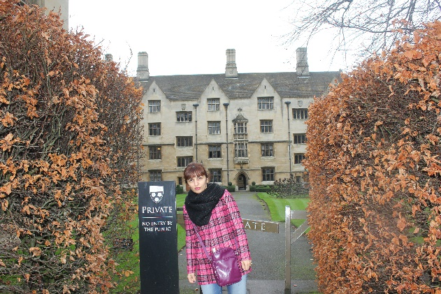
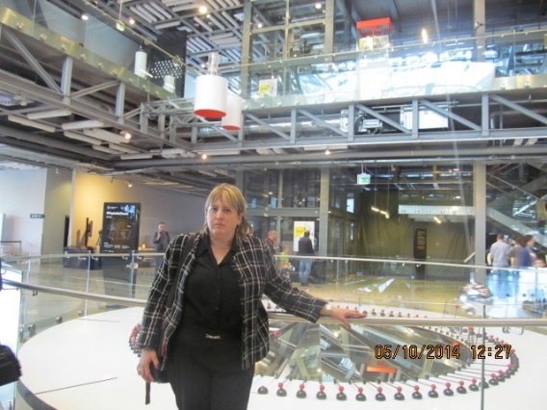
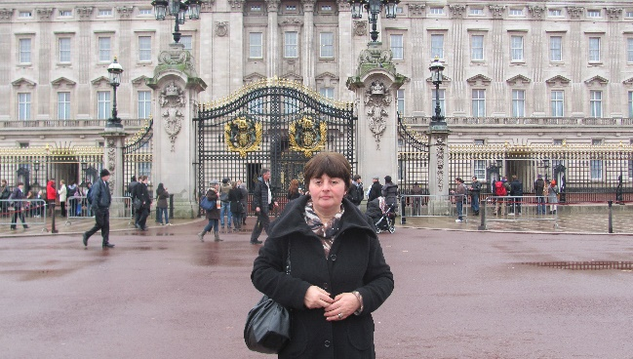
Major specifications
Instructional profile- general educational
Large contingent of pupils- 1730
Highly qualified pedagogical staff- 103 teachers

Slide 4
Highest results at school certificate exams
Highest results at national exams

Slide 5
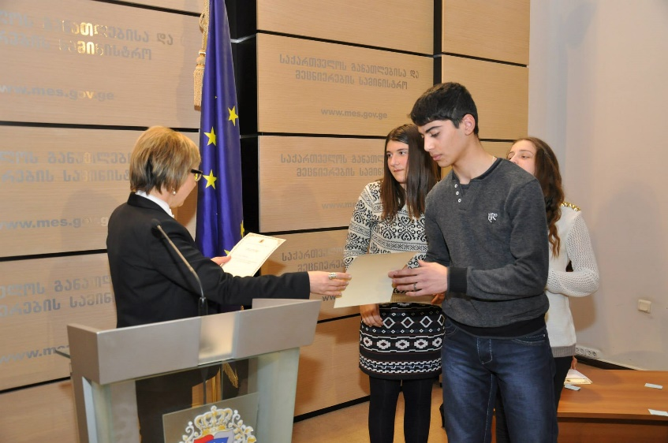
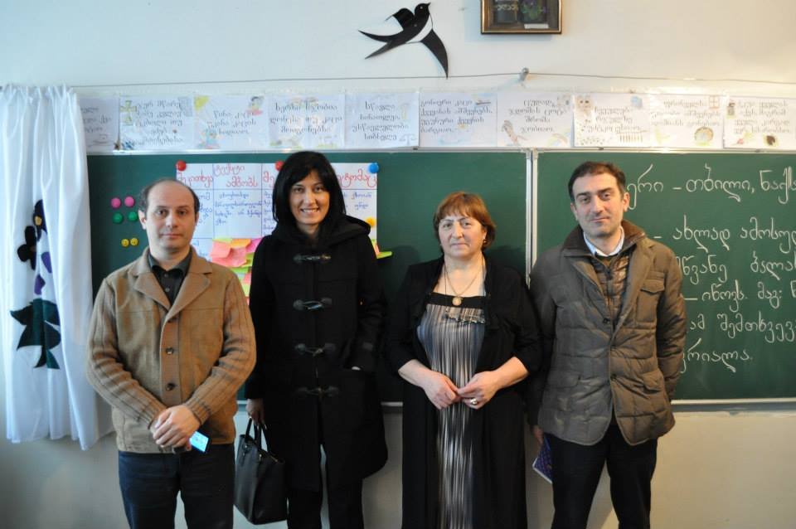
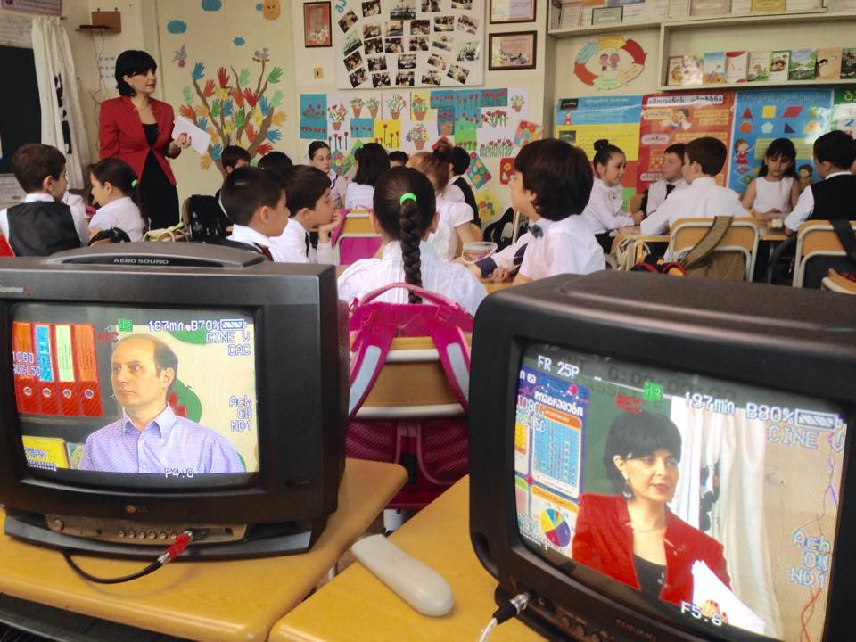
Excellent results in Olympiads and competitions
Involvement in educational projects

Slide 6
Managing the instructional process
Financial management
Resources and facilities
Current issues
Administrative/ legal issues
Management of human resources

Slide 7
Aspect #1 of the instructional process: Whom we teach- pupils
1700 pupils study at school, 62 fiscal groups in 2 shifts, 5-6-7 parallel groups
Pupil contingent- the whole town (diverse cultures and expectations)
Parent contingent- high expectations

Slide 8
Aspect #2 of the instructional process: Who teachers- teachers
Goals of administration and school achievements:
1. Establishing collaborative culture, conducting activities in coordination
2. Planning professional activities and monitoring their implementation, providing feedback
3. Teacher professional development, efficient system of assessing and motivating teachers

Slide 9
Aspect #3 of the instructional process: How we teach- instructional environment
major goal/outcome- creating efficient instructional environment
Safe and working instructional environment in the classroom.
Instructional process focused on pupils and its outcomes.
Teaching with modern teaching methodology and research system.
Guaranteeing excellent discipline for teaching/learning.

Slide 10
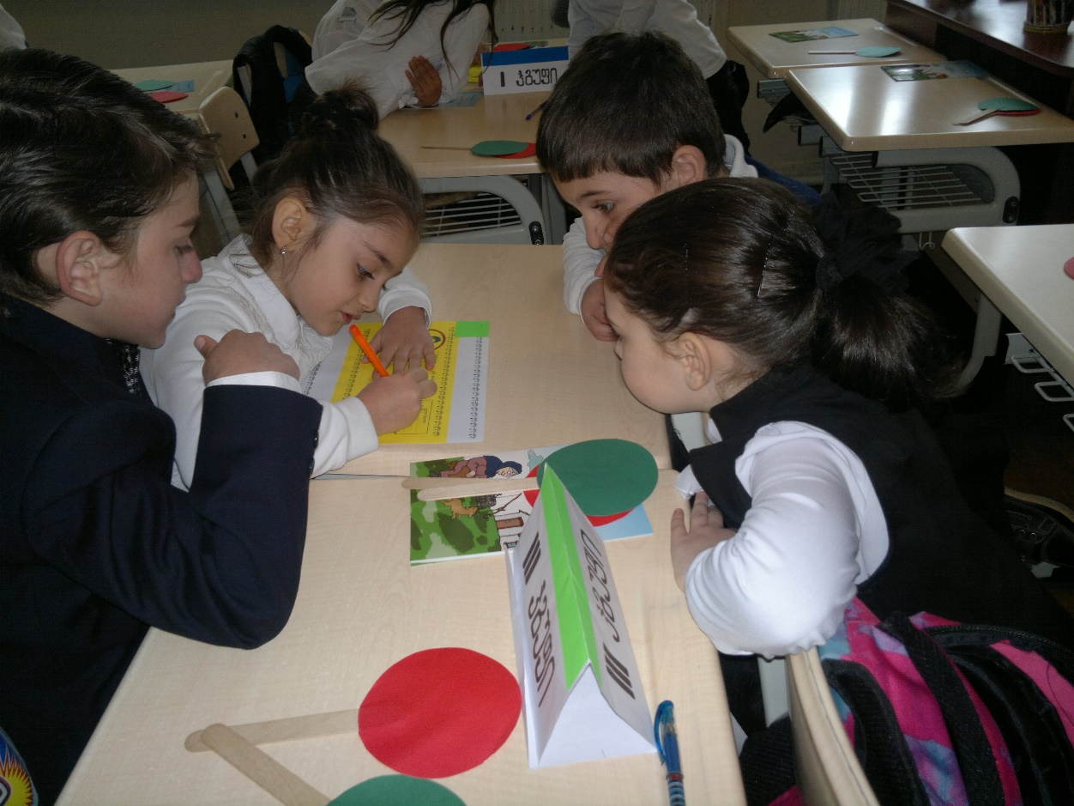
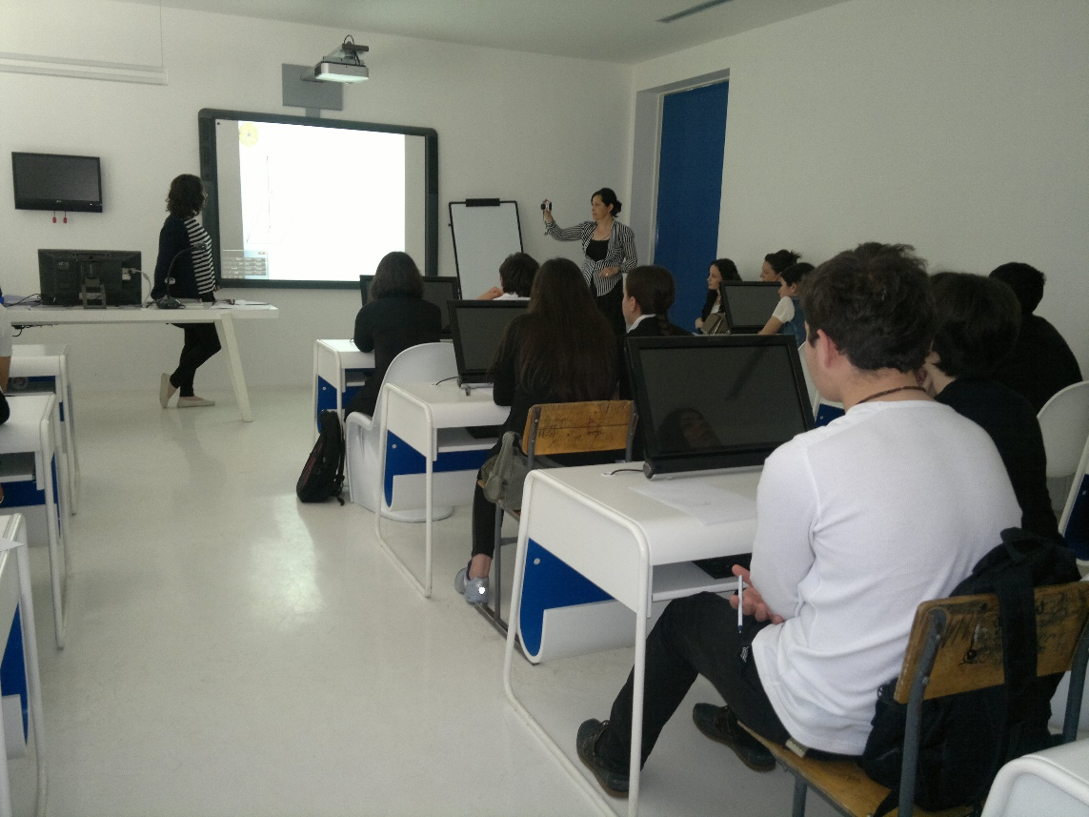
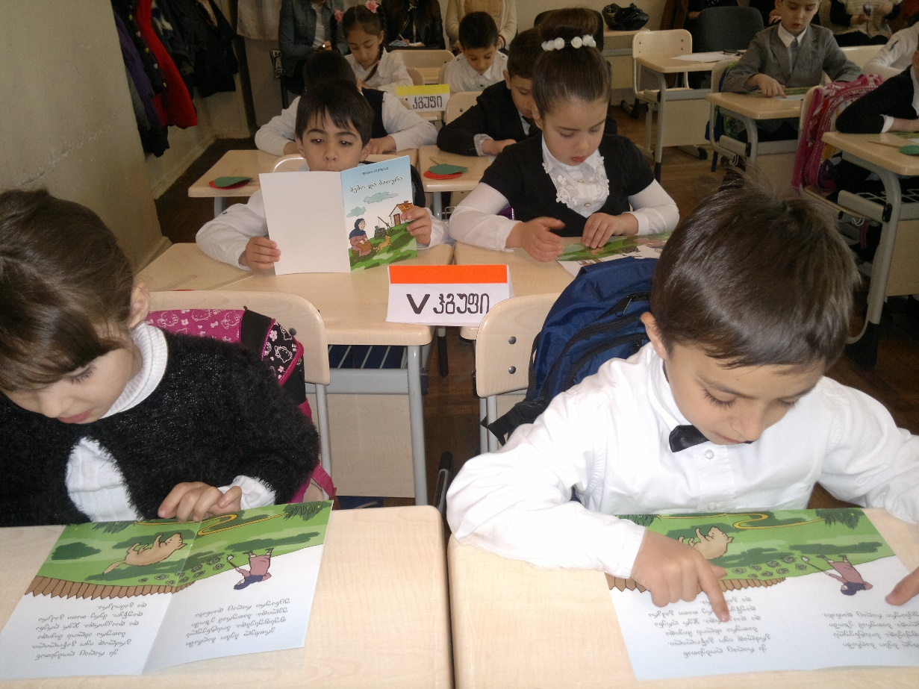
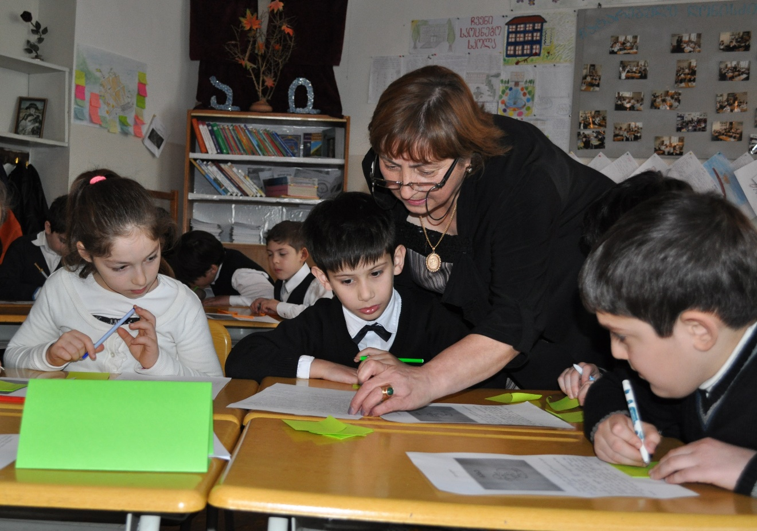
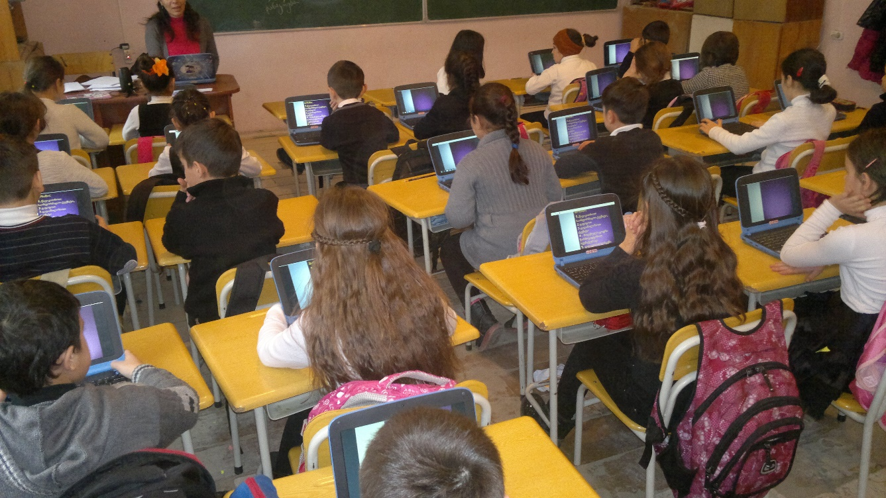

Slide 11
Aspect # 4 of the instructional process What we teach? Defining school goals- priorities
Major goal of the school: Preparing pupils for successful life through giving them quality general education.
priority of the primary level: developing reading and math literacy in each pupil;
priorities of the basic level: creating realistic expectations in pupils and parents concerning pupils’ skills and acquired at school basic knowledge;
priorities of the secondary level: creating optimal opportunities for pupils to fulfill their abilities.

Slide 12
What school did for achieving the goals?
Defining strategic and stage instructional goals
Intra-school system of teacher professional development
System of monitoring and encouraging teachers’ activities
System of semester testing at school
System of organizing teachers’ work
Establishing collaborative culture in teacher staff

Slide 13
Defining strategic and stage instructional goals
For developing reading and math skills the school started participating in G-PRIED project;
Compiling school teaching plan according to the set priorities;
Providing teachers and pupils with necessary teaching resources.

Slide 14
Intra-school system of teacher professional development
Involvement in instructional projects and conferences.
Focus on active trainings.
Sharing results of external and internal exams.
Recruiting new teachers on the basis of competition.
Participation in external researches and conducting researches inside the school.

Slide 15
System of monitoring and encouraging teacher’s activities
System of monitoring teachers’ activities has been developed and introduced:
Attending lessons and efficient feedbacks.
Comparing results of internal and external assessments.
School semester tests
System of encouraging teachers has been developed and introduced:
Mechanisms of material and moral encouragement.
Rating system.

Slide 16
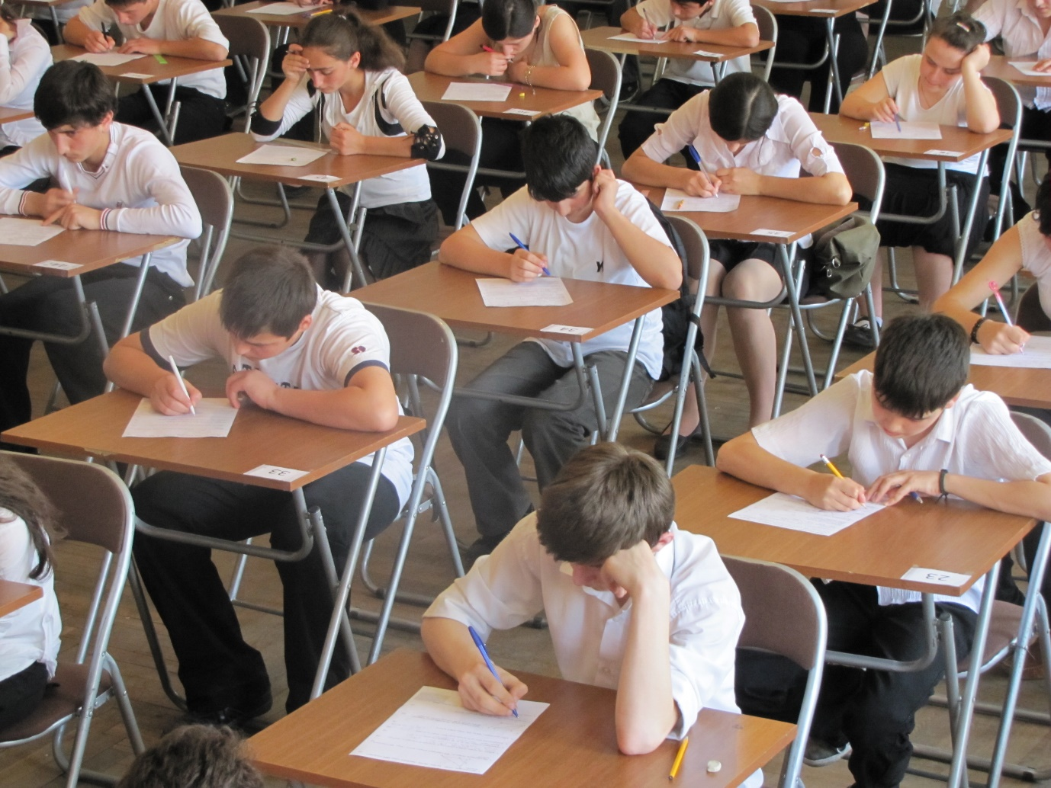
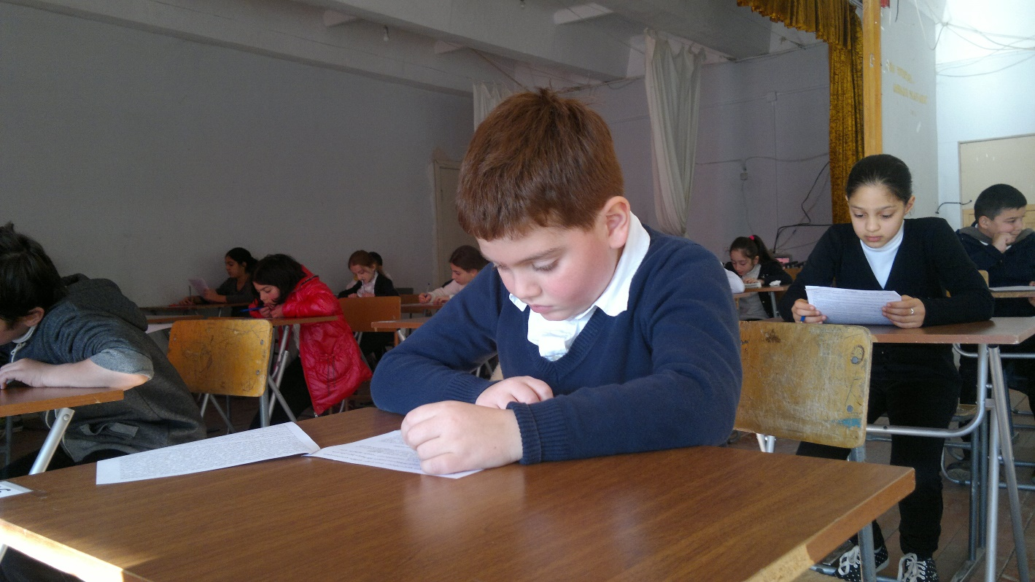
System of semester testing at school
Goals of semester testing at school:
Monitoring compliance of pupils’ achievements with the National Curriculum standards.
Major specifications of school tests.
Analysis and research of school results.
Using test results in instructional practice at school, classroom and individual levels.
Efficient usage of school tests at secondary level.
Interdependence between testing system and school results.

Slide 17
System of semester tests at school

Slide 18
System of semester tests at school

Slide 19
System of semester tests at school

Slide 20
System of semester tests at school
Joints school rating of 5th grade, semester I, acad. y. 2013-14
№ | name | surname | grade | points
1 | საბა | გოზალიშვილი | V დ | 30
2 | თეკლა | ფხალაძე | V ა | 29
3 | ანა | ჯალიაშვილი | V ბ | 29
4 | ლაშა | სულიაშვილი | V გ | 29
5 | ნიკა | გელაშვილი | V დ | 29
6 | ანზორ | გოგრიაშვილი | V დ | 29
7 | გიორგი | ირემაშვილი | V ვ | 29
8 | მარიამ | გელაშვილი(ზურაბი) | V ა | 28
9 | კონსტანტინე | კოკოვ | V ა | 28
10 | სანდრო | მაკოევი | V ა | 28
11 | ნიკა | მაჩაიძე | V ა | 28
12 | გიორგი | მიმინოშვილი | V ა | 28
13 | თათია | წიკლაური | V ა | 28
14 | გიორგი | ასანიძე | V ბ | 28
15 | ქეთევან | ბერაძე | V ბ | 28

Slide 21
System of organizing teachers’ activities
At all the level teachers’ activities are coordinated:
Holding test/quizzes in coordination.
Acknowledging each other’s success and sharing experience among teachers.
Coordinated teaching in grades 11-12 and analyzing its outcomes.
Providing teachers with teaching resources.

Slide 22
Establishing collaborative culture in teacher staff
Creating the atmosphere of trust, stability and acknowledgement.
Acting as a role model.
Assisting in identifying problems.
Support: in implementing innovative ideas, solving conflicts….
Friendly rapport with teachers.
Active usage of the method of persuasion.
Active communication with pupils and parents.

Slide 23
What outcomes has the school achieved?
At school efficient instructional environment has been established.
The school holds the first place in school certificate exams.
Pupils have impressive achievements in Olympiads and learning projects.
70 % of the teacher staff is certified and 45 teachers have maximum credits in the professional scheme.
Tens of teachers and pupils have had trips to foreign countries.
Demand on school is high and it has high rating.

Slide 24
What conclusions can be drawn?
Establishing efficient instructional process is feasible through school principal’s direct engagement at each level of it.
School community recognizes school principals’ significant role in school achievements.
Principal must conduct the instructional process so as to have complete and constantly renewable information concerning functioning of each link in the instructional process.
The major factor which affects pupils’ achievements is not highly developed infrastructure, but trust towards school.

Slide 25
Thanks for your time!
Thanks for your attention!

